Slide 1
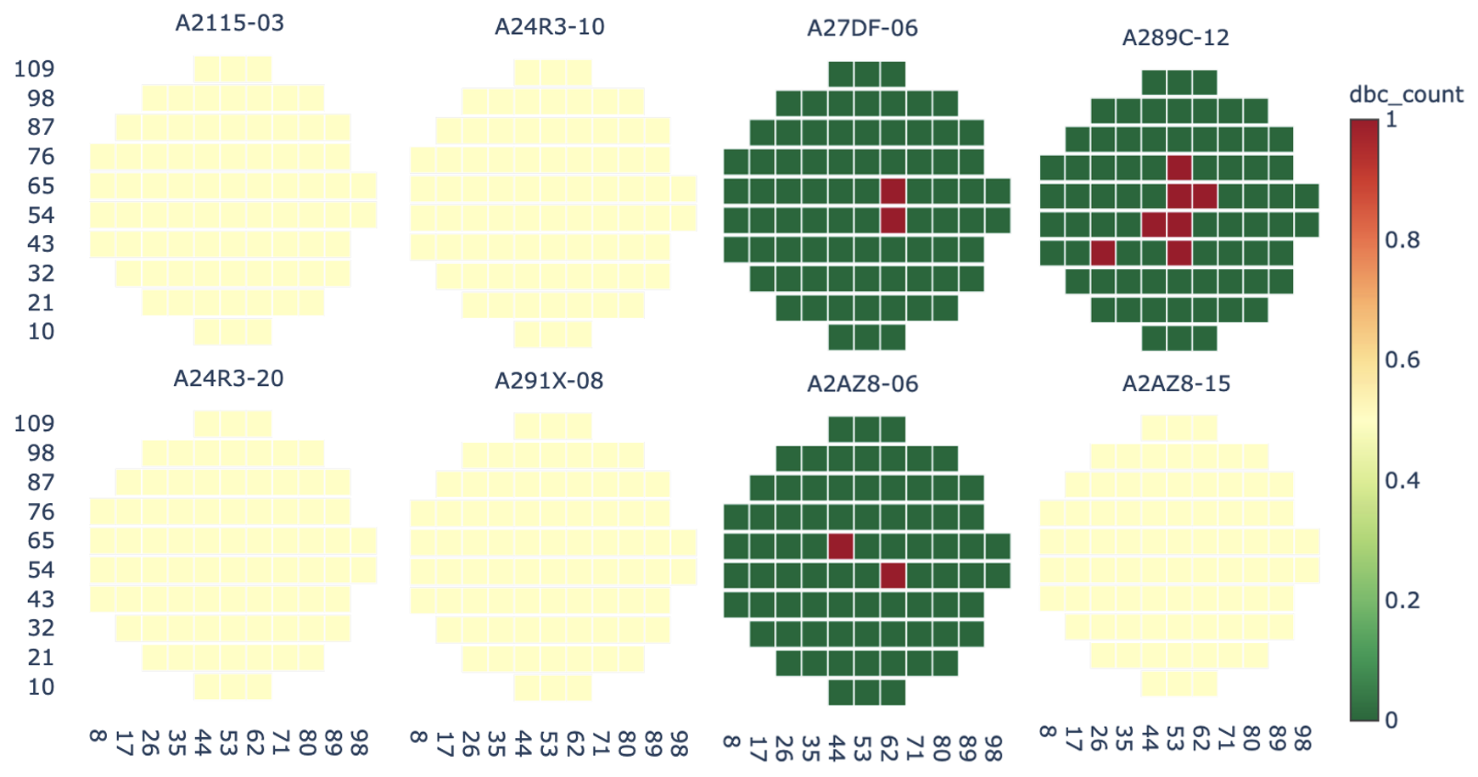
First pass with 209 wafers
Got 46 clusters
Largest cluster has 148 wafers
66 have up to 1 DBC per chip
82 have no DBC at all
Because we have wafers with up to 70 DBC on a single chip, a lot of the 1 DBC per chip wafers are clustered with the 0 DBC
If I decrease the t values from 5 to 2, I can get a largest cluster with 88 wafers where almost all of them have no DBC at all

Slide 2
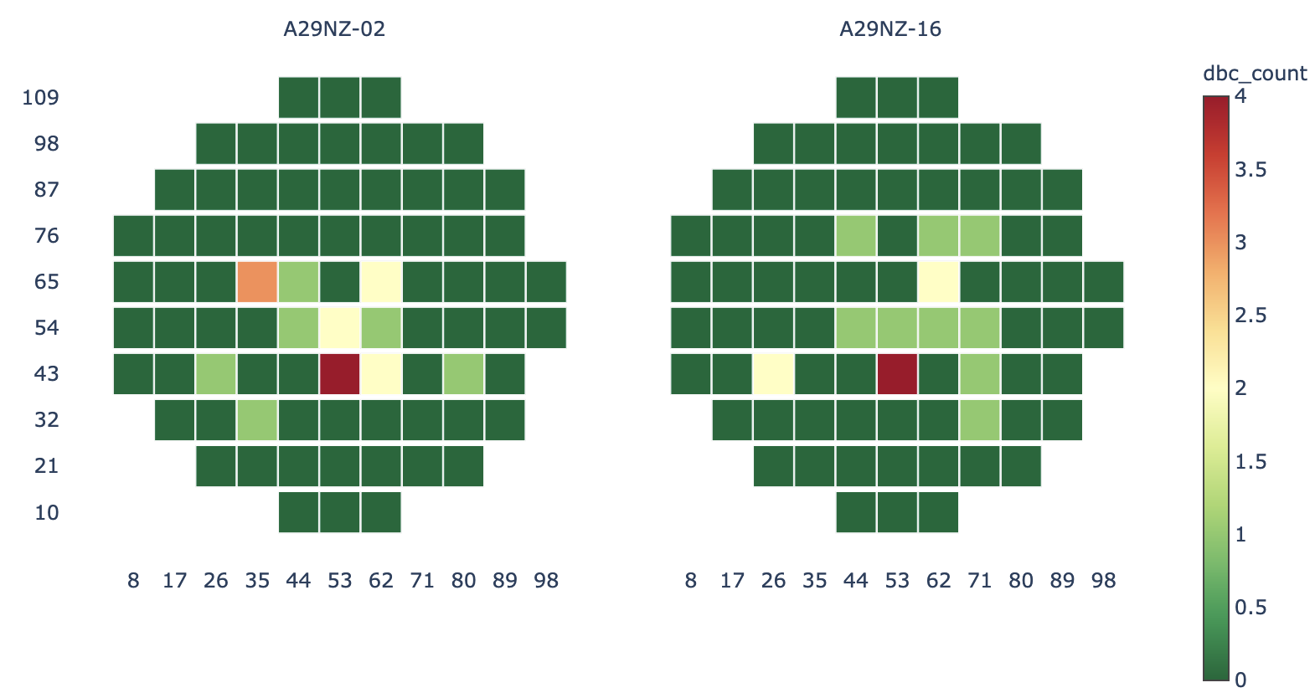
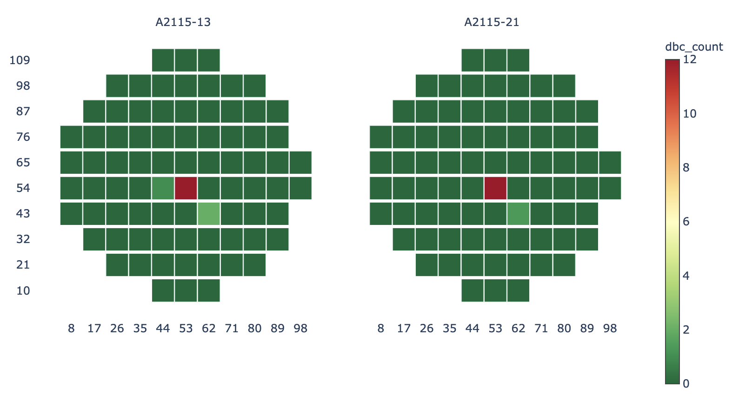
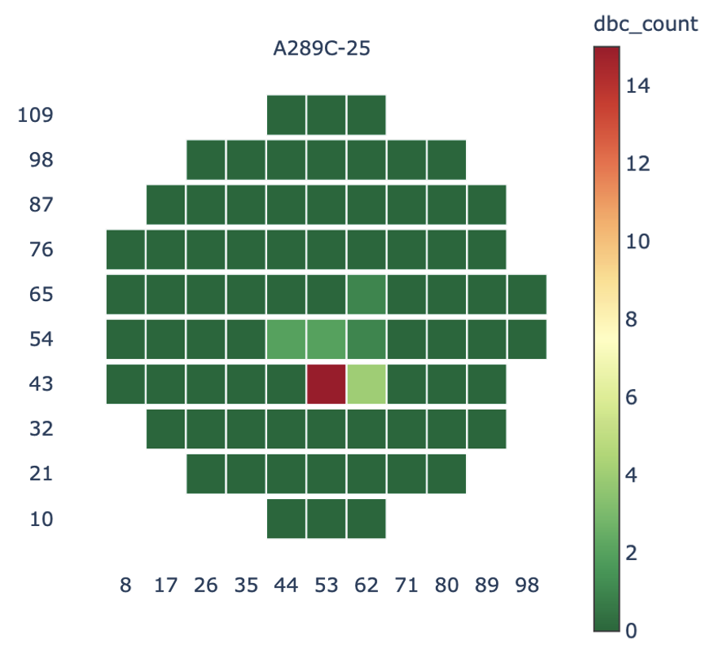
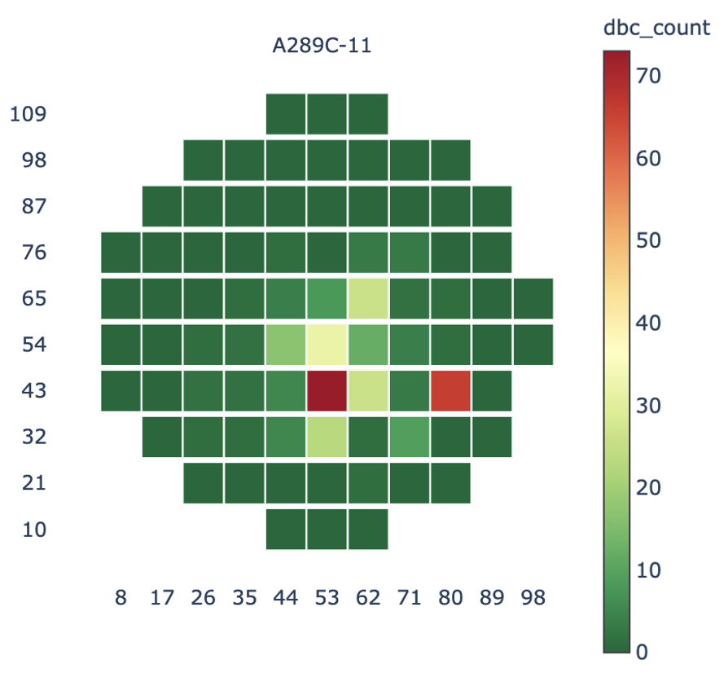
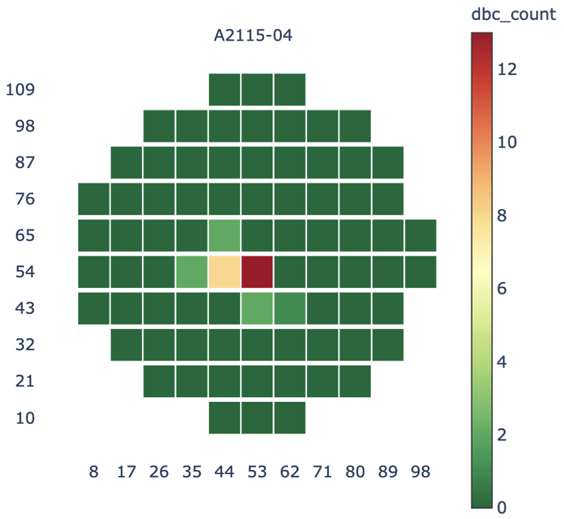
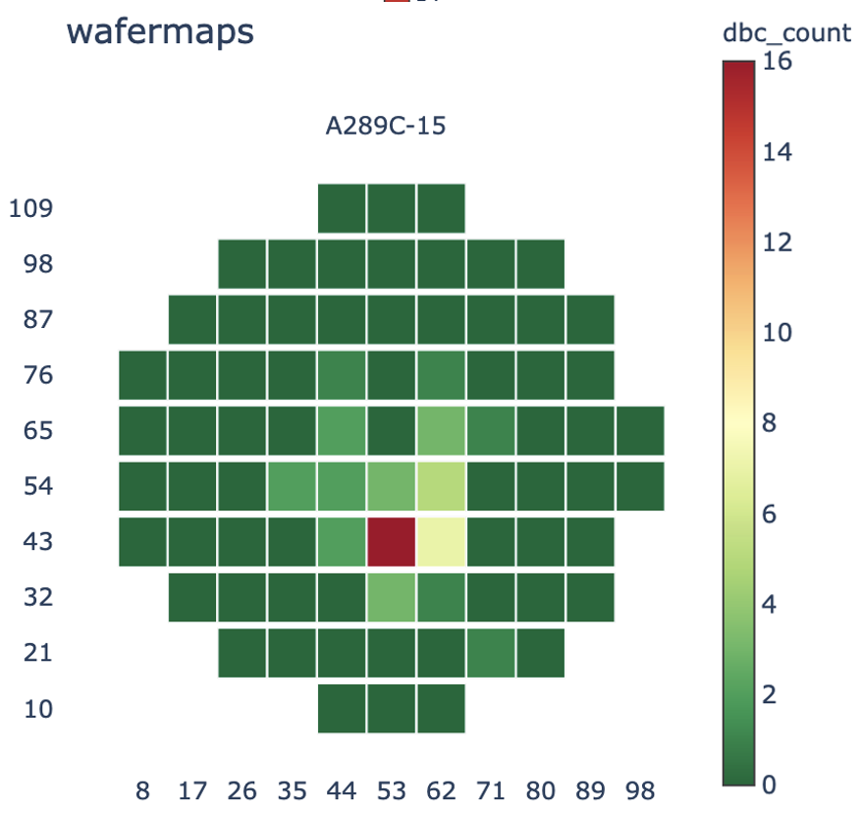
First pass with 209 wafers
Got 46 clusters
45 of the 46 clusters contain 61 wafers with CANOP
Some of these wafers with similar largest fail counts on the same chip are grouped together
Observation: Fail magnitude plays a very large role in the clustering

Slide 3
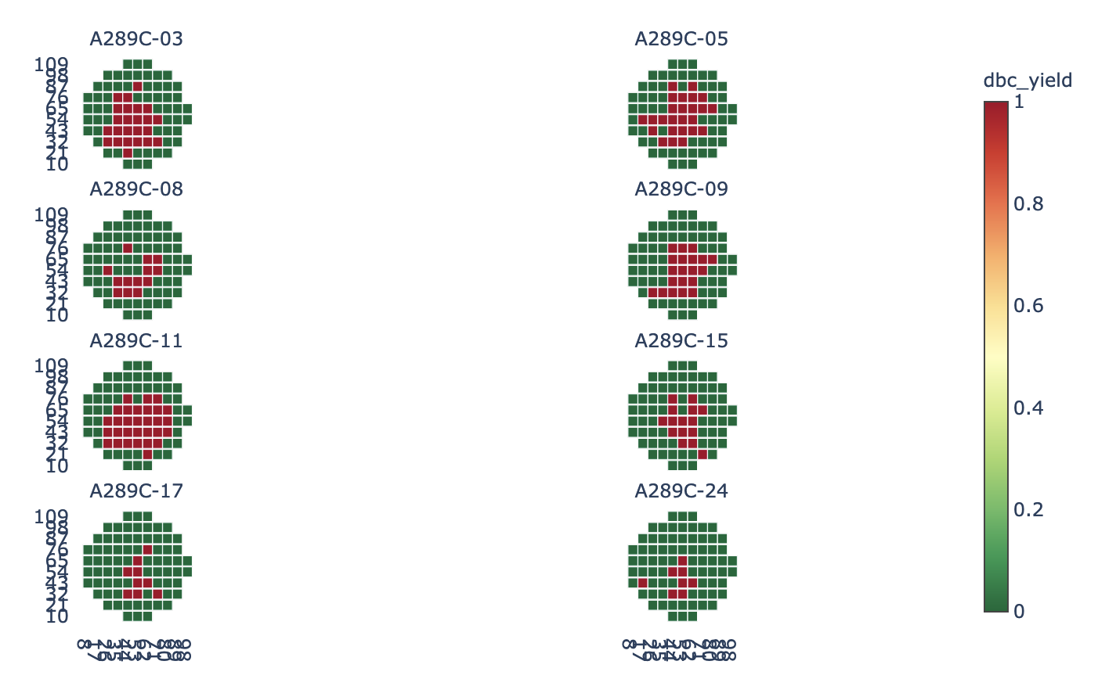
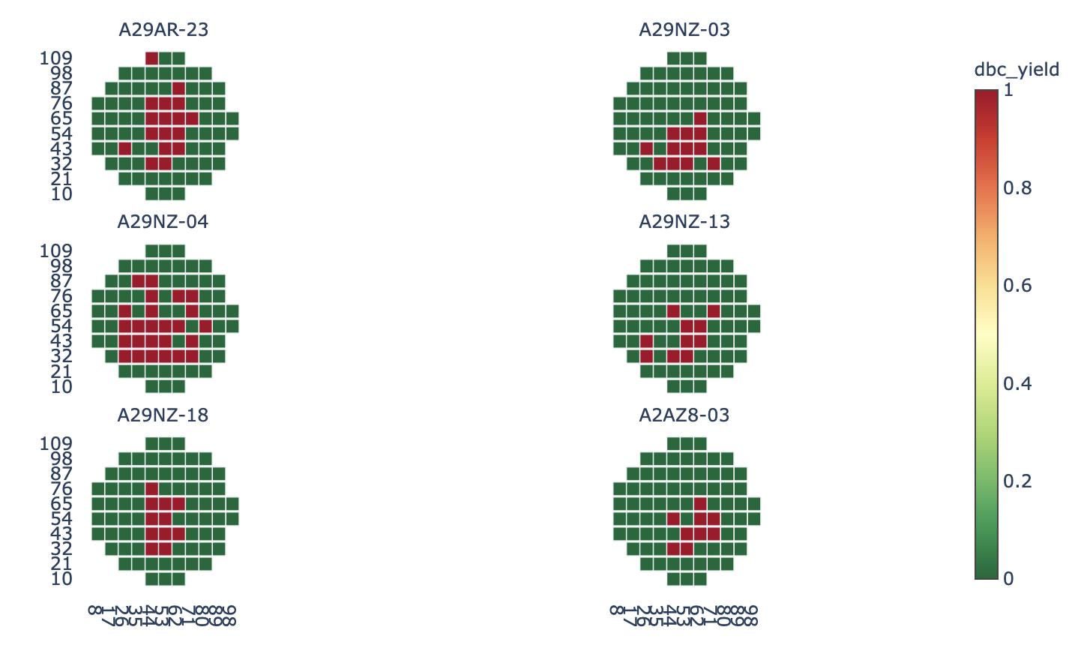
Using DBC yield instead of count
Forcing 2 clusters
Cluster 0 with 195 wafers
Cluster 1 with 14 wafers
Smaller cluster has wafers with largest area taken by DBC fails

Slide 4
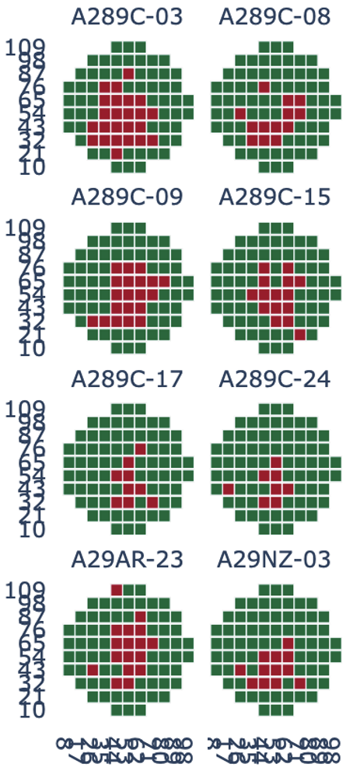
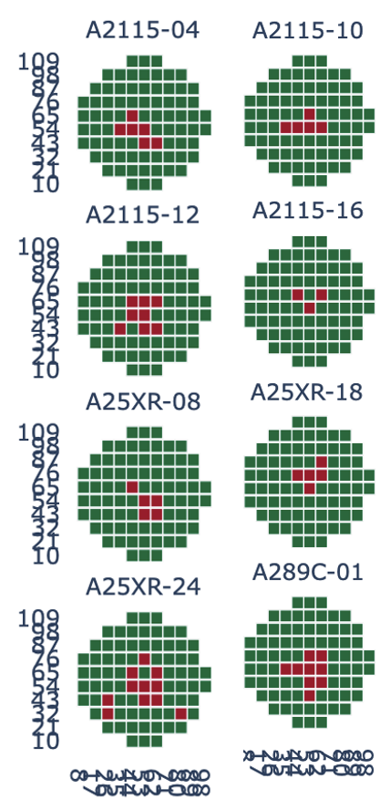
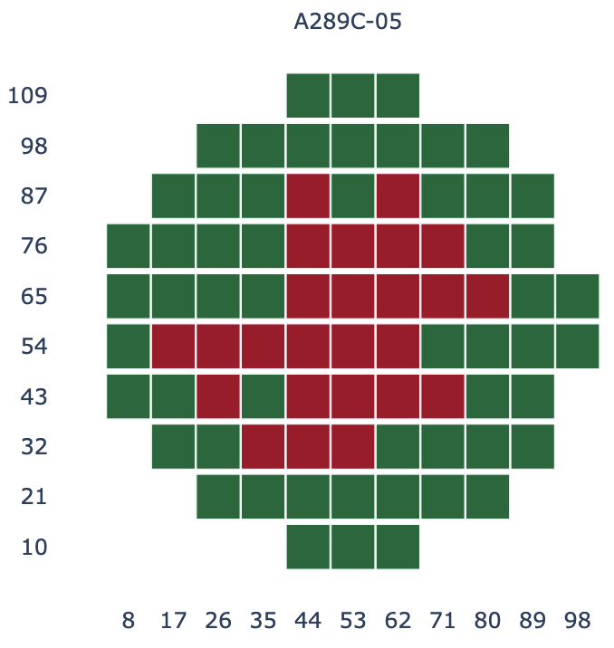
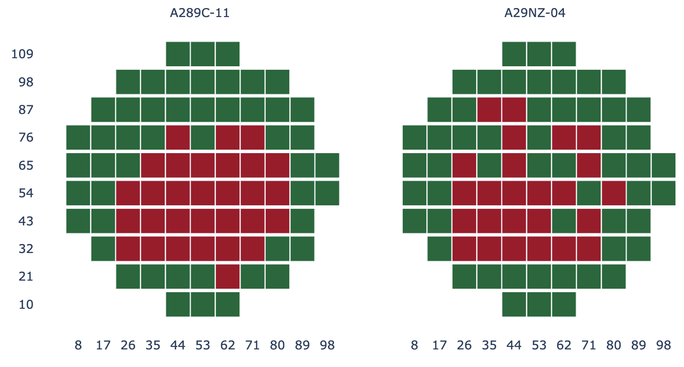
Using DBC yield instead of count
Forcing 5 clusters
Cluster 0 with 167 wafers
Cluster 1 with 28 wafers
Cluster 2 with 2 wafers
Cluster 3 with 11 wafers
Cluster 4 with 1 wafer
Cluster 2
Cluster 1
Cluster 4
Cluster 3

Slide 5
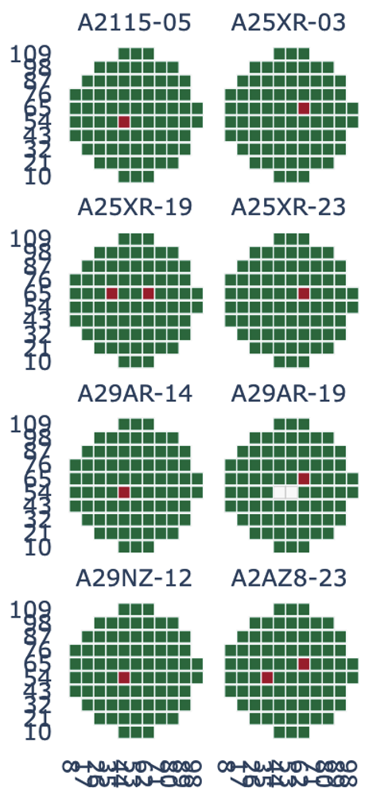
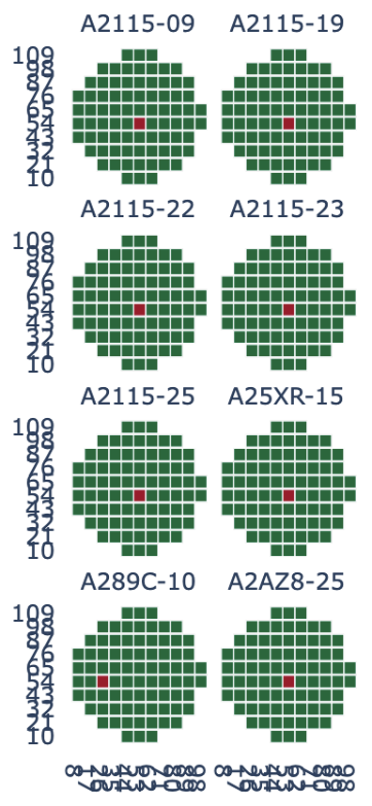
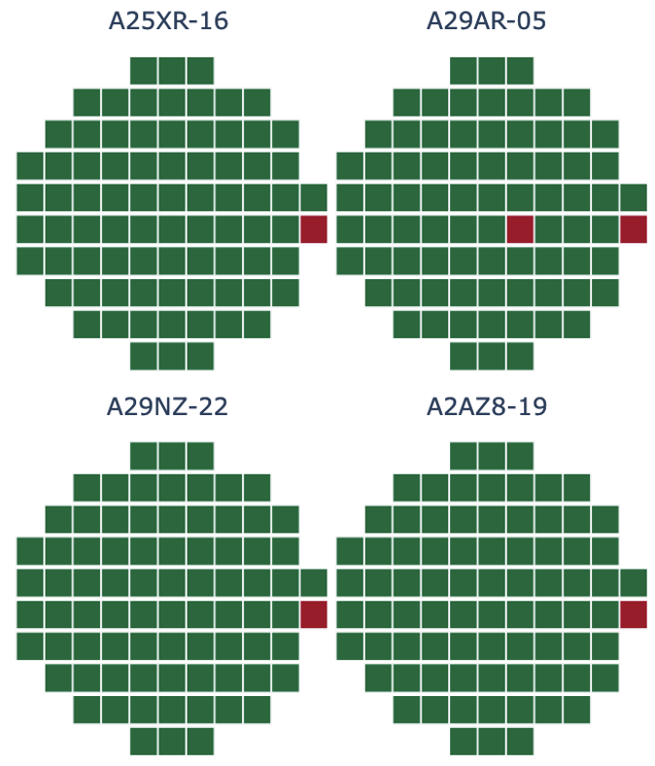
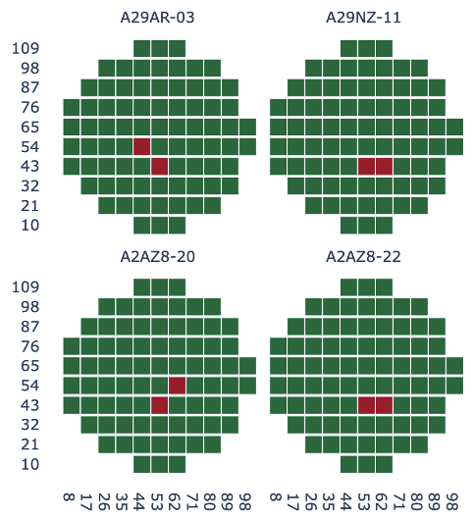
I had to force 98 clusters to get a group with only the non CANOP wafers
Cluster 0: 82 wafers (Only non CANOP wafers)
Cluster 1: 8 wafers
Cluster 2: 8 wafers
Cluster 3: 4 wafers
Cluster 4: 4 wafers
Cluster 2
Cluster 1
Cluster 4
Cluster 3

